Slide 1
Topic C851 5.4 Special Directories and Files
C851 Cohort Live Session for Sunday, November 14, 2021
Dr. John S. Galliano | C851 Linux Foundations Instructor

Slide 2
Agenda
Welcome
About the Exam
The 5 Exam Domains
Lecture: Topic 5.1 Basic Security and Identifying User Types
Demos
Wrap-Up

Slide 3

About the Linux Essentials v1.6 [1]
The 5 Exam Domains [3]
No prerequisites
Closed book, up to 60 minutes
40 multiple-choice (some multi-select and fill-in-the-blank items) questions
Min pass score 500 points (200-800 scale)
Partially correct responses not accepted (for F-I-T-B questions LPI may accept multiple correct versions of an answer [2]
Total exam weight count is 40, thus 40 questions
The Linux Community and a Career in Open Source
Finding Your Way on a Linux System
The Power of the Command Line
The Linux Operating System
Security and File Permissions
[1,3] Linux Professional Institute, “Linux Professional Institute Linux Essentials,” Linux Professional Institute, 21-Oct-2018. [Online]. Available: https://www.lpi.org/our-certifications/linux-essentials-overview. [Accessed: 14-Aug-2021]
[2] Dr. Galliano’s correspondence with LPI, dated August 2021: Example: with/without leading path in a case where the answer is a command
Notes:
Examples:
• If an objective has a weight of 3, there will be 3 questions on the exam related to that objective [2]
Links:
• View the 3rd party cert tips video at https://bit.ly/3party_cert_tips
• https://explainshell.com/ to learn about commands, options, arguments
• Dr. Galliano’s Github repo (study guide, cheatsheets, slidedecks, etc. at https://github.com/g33k247/851, specifically the user management cheatsheet at https://github.com/g33k247/851/blob/main/cheatsheets/cheat_sheet_users_groups.pdf

Slide 4

LPI Exam Re-Take Policy [4]
Anyone who takes an LPI exam once must wait one week before re-taking
Anyone who takes an LPI exam a second (and subsequent) time must wait 30 days before re-taking
3rd and subsequent attempts at your own cost ($120)
[4] Linux Professional Institute, “Privacy Statement and Policies,” Linux Professional Institute, 18-May-2018. [Online]. Available: https://www.lpi.org/policies. [Accessed: 14-Aug-2021].
Notes:
• Anyone who passes an LPI exam may not retake that exam for two years

Slide 5

Exam Topics/Weightings
Linux Essentials v1.6 Exam Topics [5] | 1.1 | 2
 | 1.2 | 2
 | 1.3 | 1
 | 1.4 | 2
 | 2.1 | 3
 | 2.2 | 2
 | 2.3 | 2
 | 2.4 | 2
 | 3.1 | 2
 | 3.2 | 3
 | 3.3 | 4
 | 4.1 | 1
 | 4.2 | 2
 | 4.3 | 3
 | 4.4 | 2
 | 5.1 | 2
 | 5.2 | 2
 | 5.3 | 2
 | 5.4 | 1
 |  | 40
[5] Linux Professional Institute, “Linux Essentials Objectives V1.6 - LPI Wiki,” Linux Professional Institute, 25-Jan-2020. [Online]. Available: https://wiki.lpi.org/wiki/Linux_Essentials_Objectives_V1.6. [Accessed: 14-Aug-2021].
Notes:
• A weight of “1” equates to 1 exam question
• Since there is a weight of ‘1’, you will see 1 question on this topic!

Slide 6

5.4 Special Directories and Files [6]
Weight: 1 (1 questions)
Description:
Special directories and files on a Linux system including special permissions
Key Knowledge Areas:
Using temporary files and directories
Symbolic links
Files used, terms and utilities:
/tmp, /var/tmp, and sticky bit
ls -d
ln -s
[6] Linux Professional Institute (LPI), “Exam 010 Objectives,” Linux Professional Institute, 21-Oct-2018. [Online]. Available: https://www.lpi.org/our-certifications/exam-010-objectives. [Accessed: 10-Jul-2021].

Slide 7

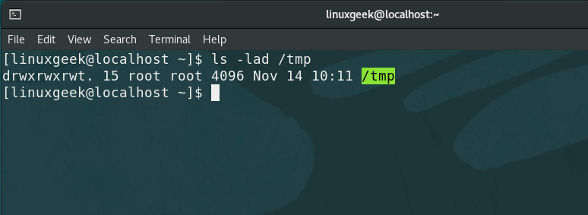
Using temporary files and directories [7]
Defined by the File Hierarchy System (FHS)
/tmp – files not preserved
/var/tmp – files usually persist
/run – run-time data used by processes
[7] C. Bresnahan and R. Blum, “LPI Linux Essentials Study Guide: Exam 010 v1.6.,” John Wiley & Sons, Incorporated, 2020. Chapter 12 [Online]. Available: https://ebookcentral.proquest.com/lib/westerngovernors-ebooks/reader.action?docID=6002518. [Accessed: 23-Oct-2021].
Notes:
Commands (‘#’ denotes a comment):
ls -lad /tmp #list only directories
ls -lad /var/tmp #list only directories
• /run directory
ls /run #list the /run folder to view files related to processes/services
cat /run/sshd.pid #view the file to show pid number
ps -efH |grep -v grep |grep sshd #show corresponding active pid in the process listing

Slide 8
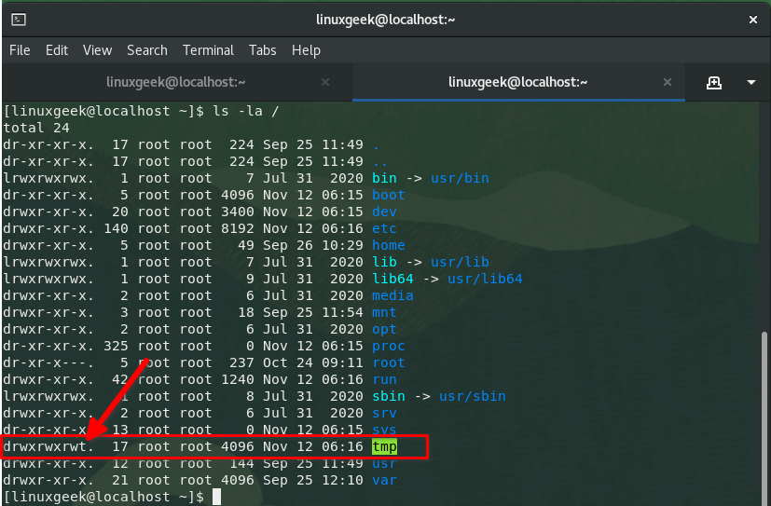
Using temporary files and directories [7]
Default permissions
The Sticky bit
Listing only directories using ls -d
[7] C. Bresnahan and R. Blum, “LPI Linux Essentials Study Guide: Exam 010 v1.6.,” John Wiley & Sons, Incorporated, 2020. Chapter 12 [Online]. Available: https://ebookcentral.proquest.com/lib/westerngovernors-ebooks/reader.action?docID=6002518. [Accessed: 23-Oct-2021].
Notes:
Commands (‘#’ denotes a comment):
ls -la /tmp/ /var/tmp #check perms on tmp directories
chmod 1755 temp/ #setting the sticky bit, use 0755 to remove
chmod +t temp/ #setting the sticky bit, use -t to remove
ls -d /home #get data only on the directory (not files)

Slide 9
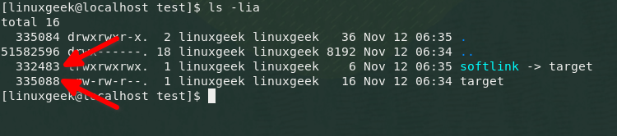
Symbolic links [7]
Also called soft links or symlinks
Symbolic links point to the path of another file (target)
Deleting the target file does not affect the soft link
Soft links are “broken” if a target file is deleted or renamed
Soft links can point to a directory or remote files
[7] C. Bresnahan and R. Blum, “LPI Linux Essentials Study Guide: Exam 010 v1.6.,” John Wiley & Sons, Incorporated, 2020. Chapter 12 [Online]. Available: https://ebookcentral.proquest.com/lib/westerngovernors-ebooks/reader.action?docID=6002518. [Accessed: 23-Oct-2021].
Notes:
Notes:
An inode is a data structure that stores attributes for an object (like a file or directory) on a filesystem
Among those attributes are the filename, permissions, ownership and on which blocks of the disk the data for the object is stored
Think of it as an entry on an index, hence the name, which comes from “index node”
Commands (‘#’ denotes a comment):
man ln #view help on the ln command
mkdir test #create an empty directory ‘test’
cd test #change to the "test" directory
echo "Welcome to C851" >target #create a new file with data
cat target #view the newfile
ln -s target softlink #create a softlink to the file
cat target softlink #view the file via the softlink
ls –lia #check the inode numbers
rm target #remove the target file
cat softlink #cannot view because the target file is gone (i.e., the lnik is “broken)
find . -type l –ls #search for all symbolic links in the current directory

Slide 10
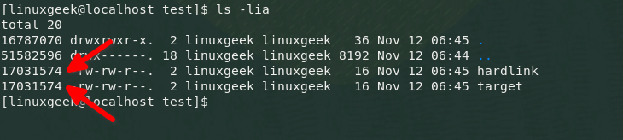
Hard links [7]
Hard links point directly to another file (target)
A hard link preserves the contents of the file (and changes)
A hard link cannot be created for directories
A hard link cannot cross filesystem boundaries or span partitions
A hard link and a target file have the same inodes
Deleting the target file does not break the hard link
[7] C. Bresnahan and R. Blum, “LPI Linux Essentials Study Guide: Exam 010 v1.6.,” John Wiley & Sons, Incorporated, 2020. Chapter 12 [Online]. Available: https://ebookcentral.proquest.com/lib/westerngovernors-ebooks/reader.action?docID=6002518. [Accessed: 23-Oct-2021].
Notes:
Commands (‘#’ denotes a comment):
man ln #view help on the ln command
mkdir test
cd test
echo "Welcome to C851" >target
cat target
ln target hardlink
cat target hardlink
ls -lia
rm target
cat hardlink
echo "Welcome to Linux" >>target #make a change to the hardlink
cat target hardlink #check both files—both files are updated

Slide 11

Demos
Based on Red Hat Enterprise Linux (RHEL)
Oracle Linux is an open-source clone
Did You Know? Oracle’s Linux distro is a clone of RHEL and used in the Oracle Cloud Infrastructure (OCI).
Notes:
Commands (‘#’ denotes a comment):

Slide 12


Exam Practice Questions
Join at slido.com #096424
ⓘ Start presenting to display the joining instructions on this slide.

Slide 13

Notes:
Interested?
• Contact the email address or connect via social media links at the bottom of the graphic
• Mention that you were referred by Dr. Galliano.

Slide 14
What Questions Do you Have for Me?

